Slide 1
Ride & Drive
Name : MEHFUZ AANSARI
Class : bca3rd
Roll no : 465

Slide 2
TABLE OF CONTENTS
01
02
03
introduction
objectives
modules

Slide 3
introduction
Introduction to the Project Car rental system is software program for car rents for travel-tour, cab operations and any other occasion for travel to manage day to operations. This project focus on cab & cars operator who have more than 20 cars & cabs in the city. Background This website is based on cars & cabs provides to ride for rent. We try to best service to provides for our customers.

Slide 4
Objective
• Designing framework for rental automobile procedure to digital method.
• Analysis of vehicle rental and validate using dynamic method using dynamic method.
• To purpose a web-based system that will help manage the business transaction

Slide 5
01
Login &sign in
Provide for our coustomers best log in option

Slide 6
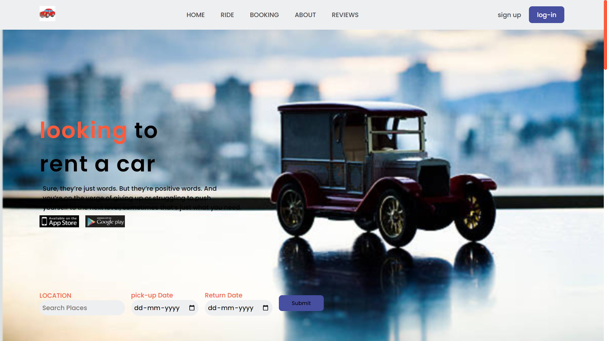
Step 1
Open web site

Slide 7
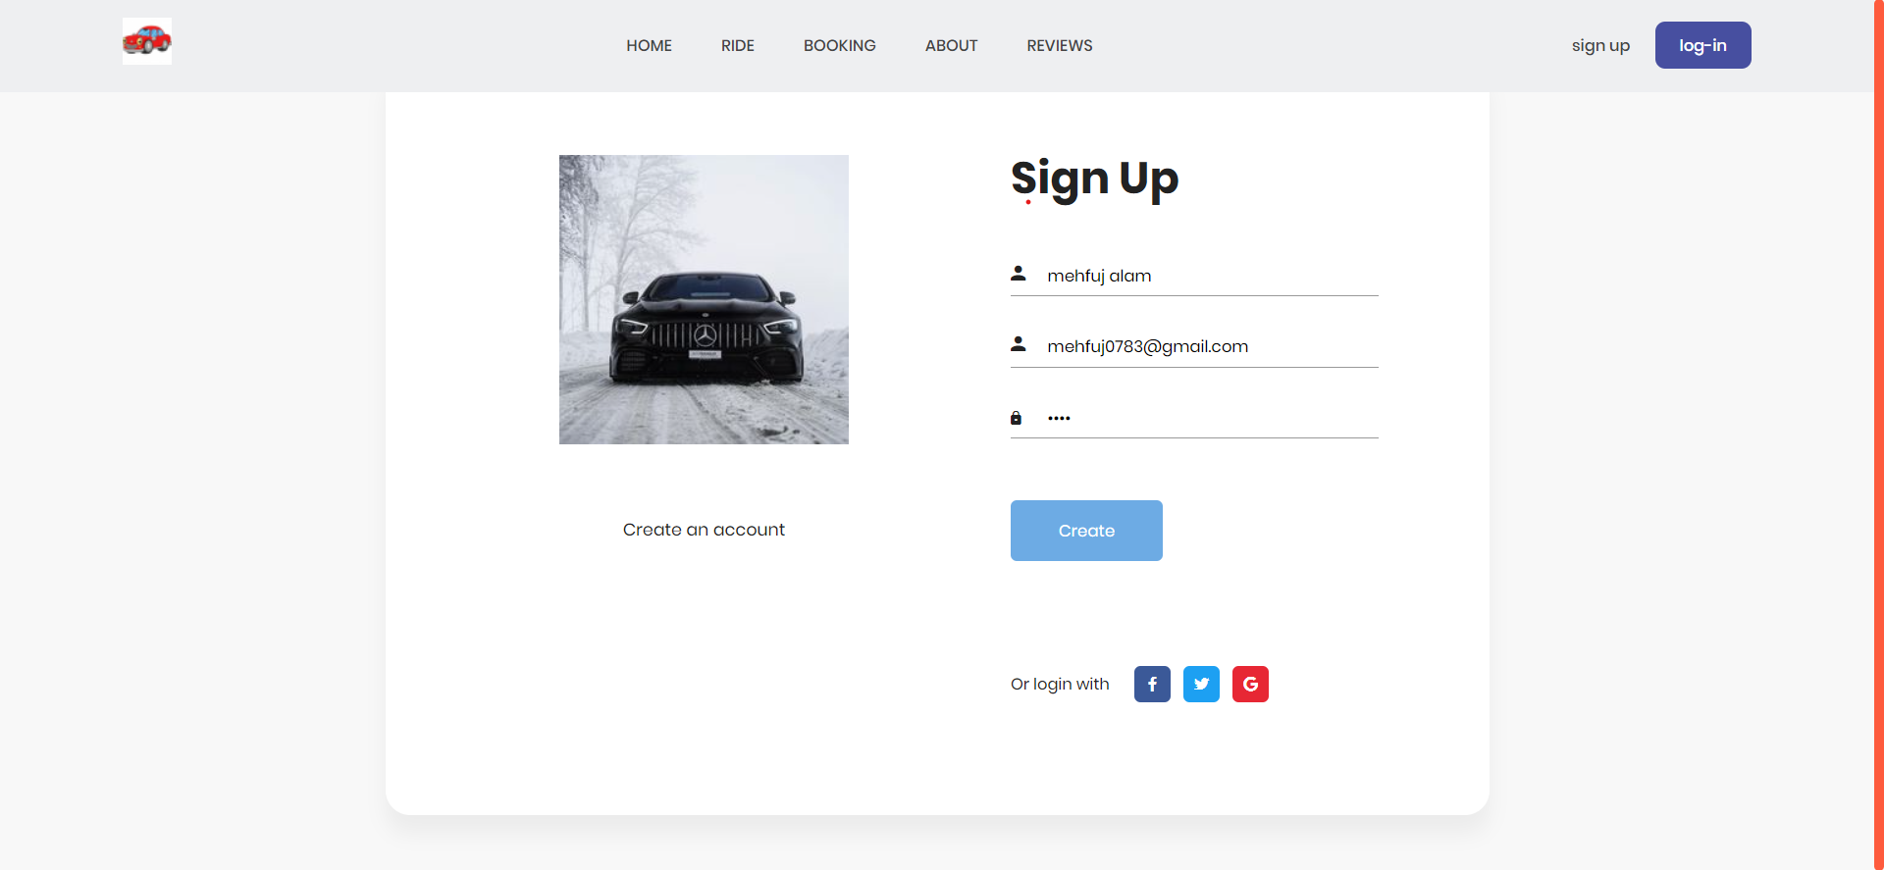
Step 2
Click on sign in option

Slide 8
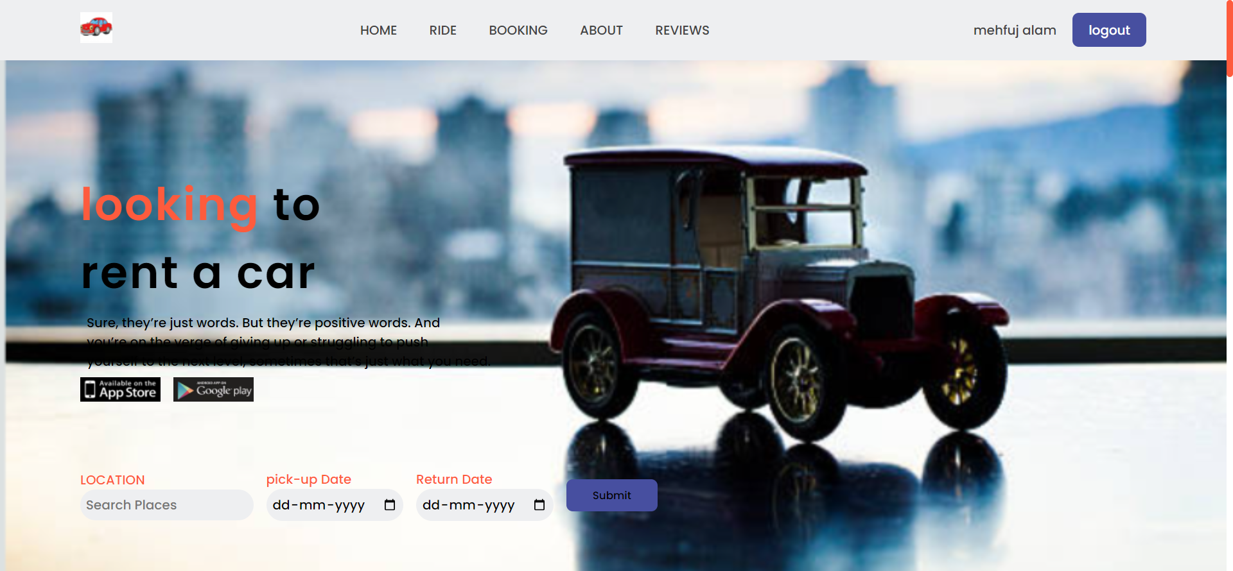
Step 3
new id is created

Slide 9
step4
After click logout

Slide 10
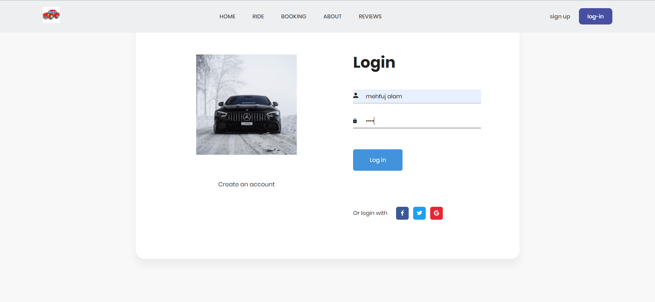
step5
Now click for login id

Slide 11
THANKS
Do you have any questions?
addyouremail@freepik.com
+91 620 421 838
yourcompany.com

